Slide 1
ESA SSA Measurement Requirements for SWE Forecasts
Juha-Pekka Luntama
Alexi Glover
Nicolas Bobrinsky
L5 in Tandem with L1: Future Space-Weather Missions Workshop
6-9 March 2017

Slide 2
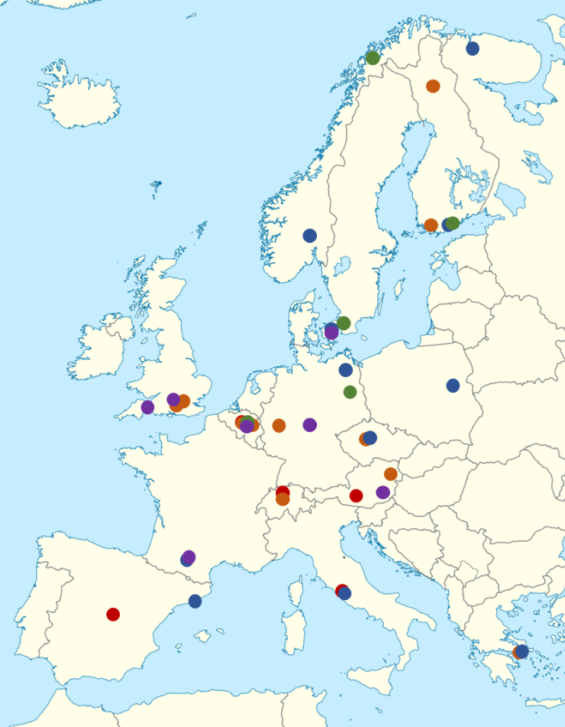
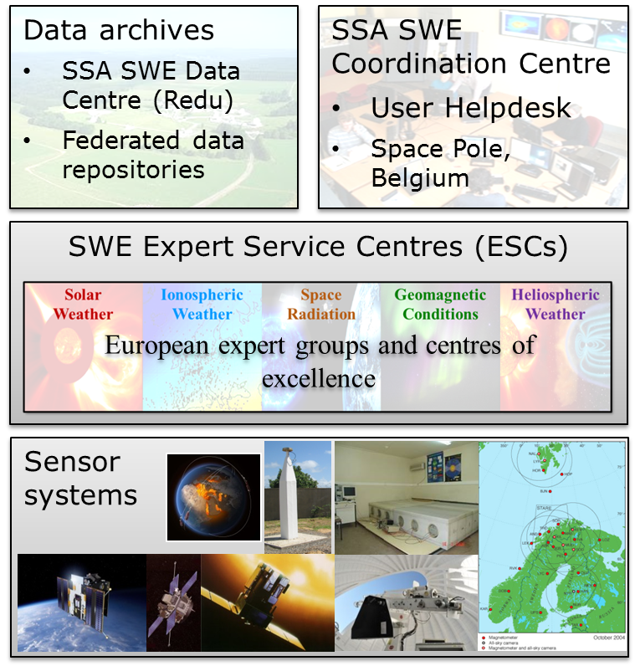
SSA SWE Network: A unique Space Weather Service System

Slide 3
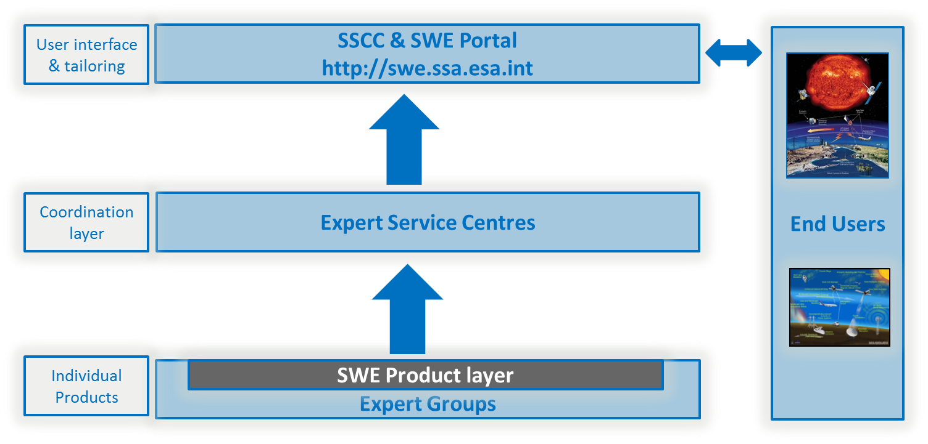
SWE Services Business Logic

Slide 4
Forecast Requirements in SWE CRD
High level requirement: detection and forecasting of space weather and its effects
Examples of more detailed requirements:
SSA system shall provide long-term solar cycle prediction
SSA system shall provide forecasts over TBD period of probability of occurrence of space weather events
The SSA system shall provide forecasts of effects for the user spacecraft
SSA system shall provide forecast and near real-time assessment of the effects of ionospheric disturbances on spacecraft operations
Forecast estimate of SEP onset with protons/ions in the range 30 MeV to 200 MeV above given flux threshold, with lead times of 1 hour
Nowcast and forecast E field in vicinity of pipelines based on local magnetometer networks and solar wind data
…

Slide 5
SSA SWE Services
39 Services based on SWE CRD
Examples of forecasting services:
Space Weather in the Solar System
In-orbit environment and effects forecast
Increased crew radiation exposure risk
Forecast of radiation storms
Atmospheric density forecast
Forecast TEC maps
Monitoring and forecast of ionospheric disturbances
Forecast of geomagnetic and solar indices for drag calculation
Space weather nowcast and forecast products (daily, weekly)

Slide 6
Forecast Products within SWE System
Example Product Chain
Distributed system built around concept of Expert Centres
Each Centre provides latest, forecast and archive information for a given domain & mapping to services
Within network, other ESCs utilise data and forecast from upstream domains:
Strengthening this networking aspect of the SWE network will form a key part of P3 developments
Solar Weather
Latest solar data & forecast
Heliospheric Weather
Latest interplanetary conditions & forecast
Geomagnetic Conditions
Global & regional geomagnetic disturbance nowcast & forecast
User driven forecast products

Slide 7
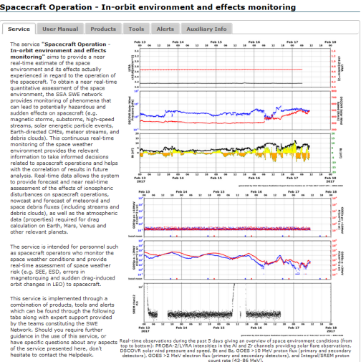
L1/L5 Enabling SWE Services
SWE Services are grouped products, tools and reporting coupled with expert user support
Mapping >300 PSD products to existing SWE 39 services. Some forecast examples
L1 IMF: 25 services targeting users from power system operators to spacecraft operators
latest data @L1 → short term forecasts & situational awareness
Forecast conditions @L5 → longer lead-time forecast
Solar EUV images off Sun-Earth line: 12 services mainly spacecraft operators and long term forecasts

Slide 8
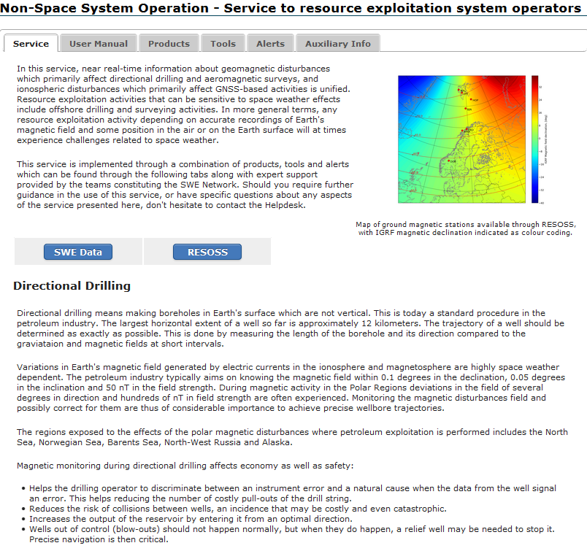
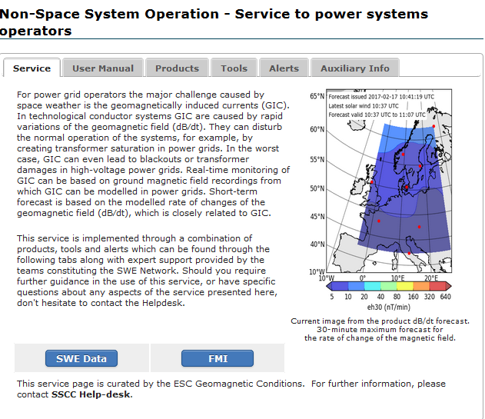
Measurements to Services: L1
Upstream solar wind critical for short term forecast
Ref. | Requirements | #services
L1-008-M | Interplanetary Magnetic Field (IMF) at L1 | 25
L1-009-M | Solar Wind Bulk Velocity at L1 | 22
L1-010-M | Solar Wind Bulk Density at L1 | 22
L1-011-M | Solar Wind Temperature at L1 | 8
L1-001-M | High Energy >10 MeV Protons in Interplanetary Medium at L1 | 19
L1-005-M | 30 keV/nuc-to-1 MeV/nuc Ions in Interplanetary Medium at L1 | 19
SU-025-M | White-light wide-angle Coronagraph Images | 16
SU-005-M | Solar Disc Magnetic Fields | 15
SU-017-M | White Light Solar Imaging | 12

Slide 9
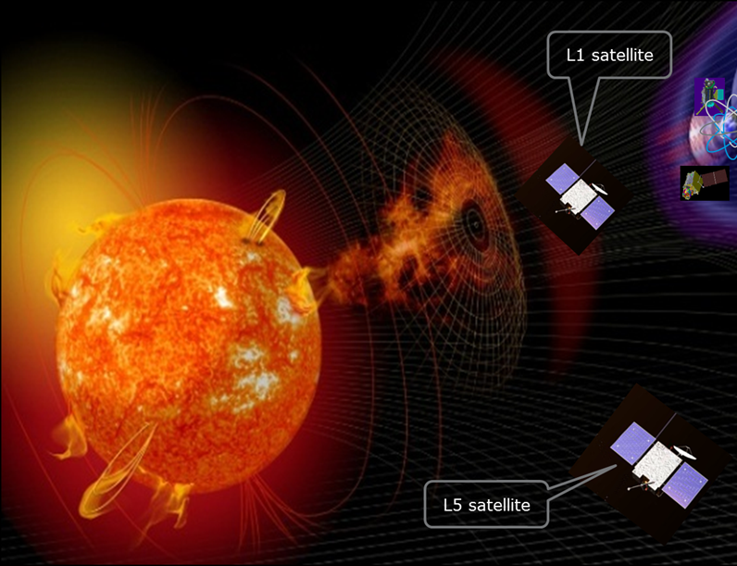
Measurements to Services: L5
L5 vantage point targeting improved forecast services
Ref. | Requirements | # services (preliminary)
SU-005-M | Solar Disc Magnetic Fields | 8
SU-017-M | White Light Solar Imaging | 2
SU-022-M | Solar Coronagraphic Images Outside of Sun-Earth Line | 17
SU-032-M | Heliospheric Imaging of Sun-Earth Line (tracking of Earth-directed CMEs) | 7
L1-008-M | Interplanetary Magnetic Field (IMF) | 17
L1-009-M | Solar Wind Bulk Velocity | 15
L1-010-M | Solar Wind Bulk Density | 15
L1-011-M | Solar Wind Temperature | 8
SU-021-M | Solar EUV Images Outside of Sun-Earth Line | 12
Development of SWE service concepts to incorporate L5 observations & modelling.

Slide 10
THANK YOU
swe.ssa.esa.int
www.esa.int

